Slide 1
WELCOME TO THE FIFSW
April 6, 2020

Slide 2
Practicum Office
Eileen McKee - Assistant Dean, Field Education e.mckee@utoronto.ca
Mindy Coplevitch - Practicum Coordinator m.coplevitch@utoronto.ca
Sun Ooi – Practicum Coordinator sun.ooi@utoronto.ca
Denise Russell - Practicum Assistant denise.russell@utoronto.ca
Catherine Connochie – Practicum Assistant catherine.connochie@utoronto.ca
Melanie LeBlanc – Coordinator, Indigenous Initiatives mel.leblanc@utoronto.ca

Slide 3
Practicum Time Requirement
CASWE confirms 337.5 hours Approximately 48.2 days
8 hour – 1 hour = 7 hour / day
September 2020 –April 2021- may start later
3 days per week-Wednesday, Thursday and Friday
OR summer 2021 BLOCK 4-5 days per week @ 337.5 hours

Slide 4
Practicum Administration System - PAS
Web based data base
Protected access to: students, Field Instructors, Faculty Field Liaison, Practicum Office, Education Coordinators
A practicum specific data base, different from ACORN
Tool to match students and practicums
Vehicle for Field Instructor and Student to complete midterm and final evaluations

Slide 5
PAS Matching Process Overview
PAS displays all practicums available
Read all practicums available in your field of study
Select 5 interviews on FORM A
Practicum Office runs the computer program
Two interview matches will be displayed on your PAS profile page
Attend 2 interviews
Rank your 2 interviews on FORM C. Field Instructors also provide feedback
Practicum Office runs the computer program
Final practicum match is displayed on your PAS profile

Slide 6
When the PAS Opens
Filter by your field of study
Many practicums are designated in more than 1 field of study
Note: Direct, indirect or mixed settings D,I,M
Read information on each practicum unit
Read carefully the requirements and ensure you can meet these ***
Ensure the practicum meets your combined-collaborative program ( if applicable)
Choose 5 practicum interviews
Choose a variety of settings/agencies

Slide 7
What You will see on the PAS Practicum Profile
Description of organization, populations served, services offered
Description of what you may do - in what activities you will be involved; will these match your competency goals?
Intervention approaches, learning opportunities
Requirements ***
Type of supervision ( individual – 1 field instructor), (co-supervision - 2 or 3 field instructors simultaneously); (rotational -2 or 3 field instructors sequentially)

Slide 8
****Requirements
For example:
Your Immunization record for practicums under the Public Hospital Act (PHA); for some non PHA sites,
drivers license, use of own or agency car, evenings, weekends, 2 step TB test, N95 Mask fitting, influenza vaccination ( flu shot), police and vulnerable persons sector screening, flexibility in hours, second language, comfort working with the population being served, moving between multiple office locations, home visits, lived experience,
professional documentation, record keeping and report writing etc.
N95

Slide 9
PHA Requirements
Students whose practicum is in a health care facility under the PHA:
Must be in compliance with immunization requirements as set out in legislation (Practicum Office will provide details and the immunization record form which must be completed by your health care provider)

Slide 10
PHA Requirements
The completed immunization record form is emailed in confidence to the FIFSW external nurse who reviews and confirms compliance/clearance
Unfortunately, failure to be in compliance may delay or cancel a practicum

Slide 11
Requirements
NOTE: There may be costs associated with requirements: For example:
TB test or health care provider completing FIFSW immunization form
N95 Mask Fitting – approximately $40.00 (delayed)
Vulnerable Sector Screening ( in Toronto in 2019 was $20.00 by certified cheque or money order)
Vulnerable sector screening in other jurisdictions
Parking, Public transportation costs

Slide 12
Regulatory College or Board
Before selecting practicums, familiarize yourself with the application and registration requirements of the regulatory body in which you intend to register
The regulatory body`s requirements may affect practicum selection

Slide 13
Accessibility Services
If accommodations are required, you must register with U of T Accessibility Office. The Practicum Office will work with you
Please notify the Practicum Office as early as possible even before the deadline for new/incoming students to register with Accessibility Services

Slide 14
Sample Screen Shots
All Practicum Units
Form A - Student Request for Practicum Interviews
Form C – Student Feedback After Practicum Interviews

Slide 15
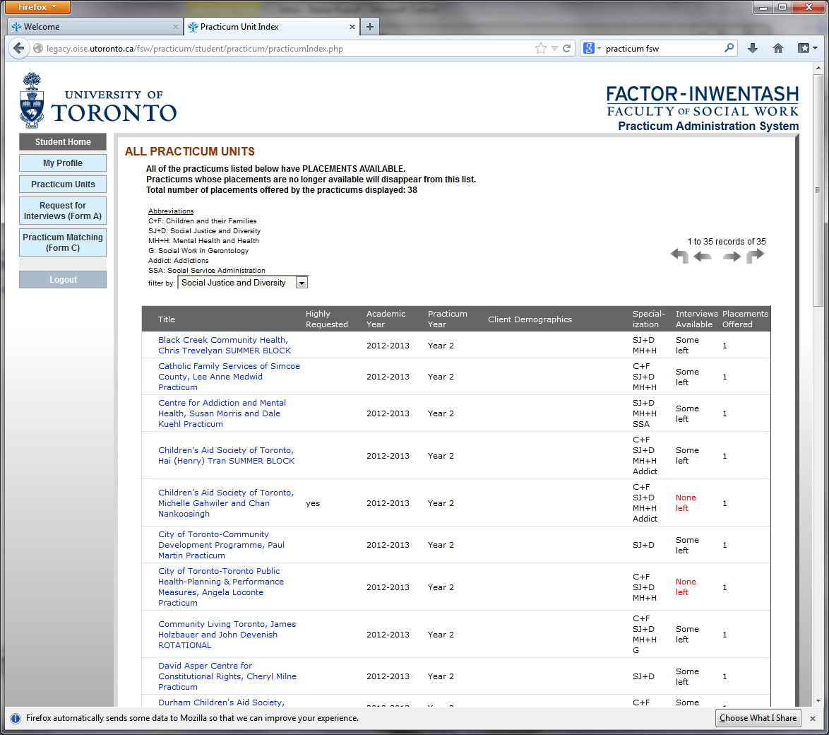

Slide 16
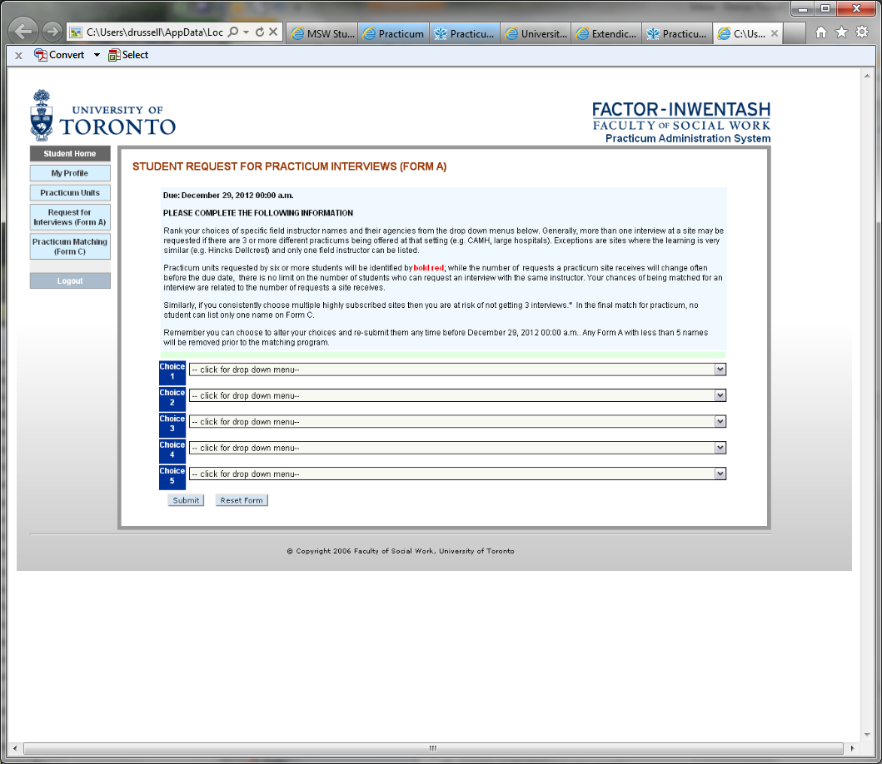

Slide 17
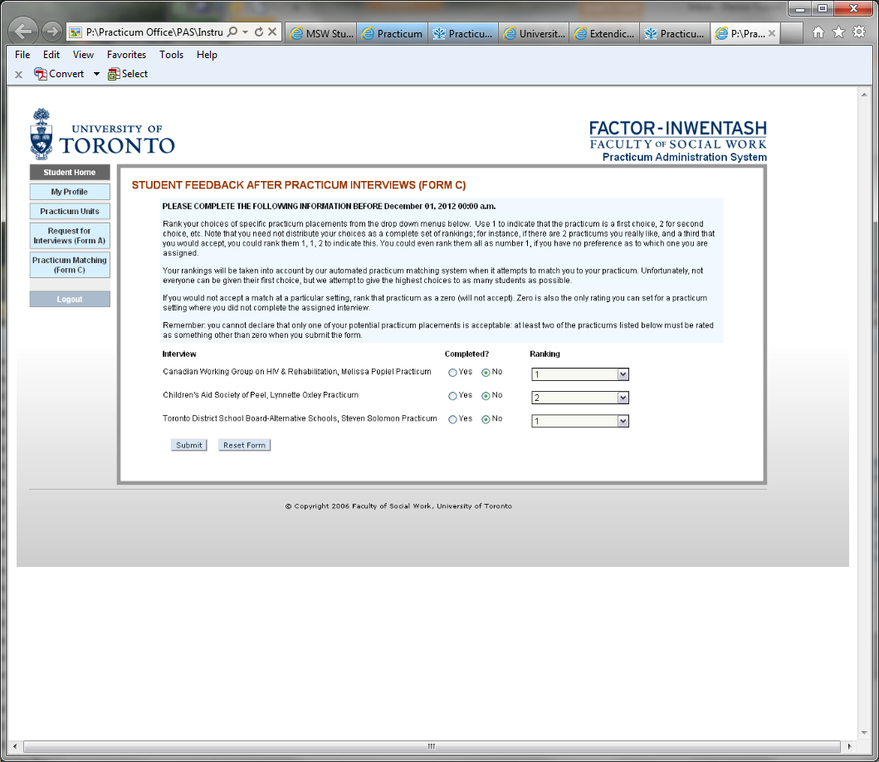

Slide 18
How the PAS Works
Once you submit FORM A indicating your 5 ranked selections:
The PAS computer program determines the matches in two stages: 1. works towards matching the most students with one of the five selections; and,
2. tries to improve the interview matches by moving up your rank order if possible
It is possible that the PAS outcome results in your match to 0 or 1 interview at the first round. This is not uncommon.
If you are not matched with 2 interviews at the time of the first computer program run, you will select another practicum.
All students will be matched with 2 interviews.

Slide 19
How the PAS Works
RED will pop up on the name of a practicum when 10 students have submitted the same
“UPDATED”, “NEW” practicums will be displayed in red
FORM A can be submitted AS MANY TIMES as you wish before the final submission date. You may change your mind until the final date and time
The PAS is not static. The majority of practicums are uploaded when the PAS opens. However, practicums are added and others are withdrawn by the organizations through the process

Slide 20
FORM A
Rank order 5 selections on FORM A
The PAS will NOT accept less than 5
There is no benefit to submitting early. All are considered on the final date/time, after which no submission will be permitted
You can resubmit FORM A as many times as you wish before the deadline
The detailed schedule and time lines will be communicated by email and on the FIFSW website

Slide 21
The Interviews
If the result is 0 or 1 interview match after the first computer program run, the Practicum Office will contact you to choose an additional practicum
Revisit the PAS and select again. Instructions will be provided
Newly received practicums are only offered to students who are matched with 0 or 1 interview.

Slide 22
The Interviews
When the PAS opens to view your interview matches, you may contact the Field Instructors to arrange the interviews
The Field Instructors will also see your name
If you are assigned 1 interview at the outset, please make contact with the Field Instructor for the interview
The Practicum Office will continue to work with you for a second interview

Slide 23
The Interviews
Initiate first contact to the Field Instructor by phone and email. When there is more than one Field Instructor - contact all and then confirm who will be the main contact person, unless otherwise indicated on the PAS

Slide 24
The Interviews
The depth of the interview may vary between organizations – from informal/casual to highly structured. It is at the discretion of the organization
You may be asked to talk about your BSW practice or volunteer/work experience; respond to case scenarios; write sample case notes or process recordings; meet with the entire team, etc.

Slide 25
The Interviews
We know you know: This is a professional interview. Arrive prepared and knowledgeable about the organization
Ask Field Instructors if they wish to receive a cover letter/resume ahead of time
Let them know what you wish to learn

Slide 26
Post Interviews
Using FORM C
FORM C is your feedback form to rank order the two interviews
Both fields must be filled
If after the interview(s) you believe the practicum is of concern, contact the Practicum Office immediately – BEFORE YOU SUBMIT FORM C

Slide 27
Post Interviews
Following the interviews, field instructors also provide feedback to the PAS in confidence

Slide 28
Practicums Outside of the PAS Process
On the FIFSW website: “Competitive practicums” (competitive because they are open to other academic institutions), outside the GTA and some unique opportunities
Each may have an application process and application date that is not aligned with the PAS process
You may apply to these practicums AND join the PAS process

Slide 29
Practicums Outside of the PAS Process
If you accept a competitive, unique or outside the GTA practicum you need not be part of the PAS process

Slide 30
Practicums Outside of the PAS Process
Please contact the Practicum Office:
If you wish to explore a practicum in your home community (province, state, country). Most likely the geographic location will be at a distance from the FIFSW during the academic year course work. A summer practicum will be explored
Three international opportunities may be available in summer 2021 because we have exchanges with Hebrew University, University of Edinburgh, and University of Melbourne.

Slide 31
Practicums Outside of the PAS Process
If you have personal circumstances for which the Practicum Office may be a support
Dropping the September 2020 practicum and registering for summer 2021 as a 4 or 5 day BLOCK
Part time students thinking about practicum in the future

Slide 32
Practicums Outside of the PAS Process
Anyone not taking the practicum course in September 2020 must DROP the course and register when ready to begin
If you wish a summer 2021 practicum advise the Practicum Office as soon as possible. You will not be included in the PAS matching process. Contact the Practicum Office no less than 4 months ahead of the semester you wish to start

Slide 33
International Practicums
Students approved for a practicum exchange outside of Canada are required to register with the Centre for International Experience (CIE)
For information about potential financial support, please view the CIE website at
http://www.studentlife.utoronto.ca/cie/outbound-apply.
The FIFSW will also have a designated person to help navigate

Slide 34
Please Note
Our partner organizations have set out clear protocol on how they wish to offer practicums. Their main contact is the Practicum Office
Please do not initiate personal or informal arrangements
If you are wondering about a practicum or have thoughts about a practicum which you do not see listed, please contact the Practicum Office. We are pleased to discuss

Slide 35
Schedule
Detailed dates, times and deadlines will be communicated to you as soon as possible via email and on the Practicum page of the FIFSW website.
As a reminder:
When the PAS opens:
View practicum opportunities. You will have about one week to read all
Select 5 interviews using Form A
Complete and submit Form A.
The PAS closes for about 3 days to run the computer program

Slide 36
Schedule
The PAS will reopen to view your 2 interview matches
Note again: Some students may find they have 1 interview or 0 interviews. This is not unusual. The Practicum Office will work with you.
May/June interviews occur.
FORM C will be submitted with your 2 rankings
Field Instructors also input their feedback Yes or No on the PAS

Slide 37
Schedule
After you submit FORM C the PAS is again closed for about a week to run the computer program
The PAS reopens to view your confirmed practicum
You may not be matched with a practicum at this time. This is not unusual. The Practicum Office will work with you.

Slide 38
Faculty Field Liaison (FFL)
Your assigned FFL is your “go to” person
Meetings with your FFL occur at the FIFSW throughout the academic year (Approximately 4 group meetings).In September look for dates on the schedule posted on FIFSW website
Attendance is expected
FFL and students are matched in September

Slide 39
How to Get Information
Contact anyone in the Practicum Office
FIFSW Website: Check the Practicum Schedule and out of the PAS practicum opportunities
Review the Practicum Manual
Emails from the Practicum Office, Associate Dean and Dean’s offices

Slide 40
Enjoy the Journey
When you receive your U of T email please update your PAS profile

Slide 41
Questions

