Slide 1
WELCOME SESSION Practicum Matching
October 2019

Slide 2
WELCOME TO THE
FIFSW

Slide 3
Practicum Office 4th Floor
Eileen McKee - Assistant Dean, Field Education e.mckee@utoronto.ca
Mindy Coplevitch - Practicum Coordinator m.coplevitch@utoronto.ca
Miri Ben Dat – Practicum Coordinator miri.ben.dat@utoronto.ca
Denise Russell & Catherine Connochie Administrative Assistants practicum.fsw@utoronto.ca
Mel LeBlanc –works with students in ITR Field of Study

Slide 4
Role of the Practicum Office
Administer the practicum course
  Match students to the field
  Prepare Field Instructors
  Work with Faculty Field Liaisons
  Secure field placements
  Monitor field placements
  Problem solve and mitigate obstacles in practicums

Slide 5
Your Teaching Team
Field Instructors/Educational Coordinators (where applicable) at the practicum setting
Faculty Field Liaison(FFL) – yours and the field instructors “go to person” for questions, and concerns for the duration of the practicum. Name is assigned on your PAS profile
Practicum Office
Faculty, Faculty Advisor, Buddy, Student Life, Outreach & Equity Advisor, FIFSW Registrar, Accessibility Services

Slide 6
Practicum Office
At FIFSW it is the responsibility of the Practicum Office to secure practicums
Students are asked not to contact organizations
Practicum Office adheres to standards set by CASWE (national accrediting body for social work education)

Slide 7
PRACTICUM I Competencies
generic foundation for learning social work practice.
designed to provide an introduction to the skills and competencies required for direct social work practice with diverse client systems.
All settings offer two levels of intervention: direct practice and indirect practice

Slide 8
PRACTICUM I
WILL PROVIDE YOU WITH THE OPPORTUNITY TO:
link theory and practice
acquire skills to develop therapeutic alliances
acquire professional practice competencies
develop the ability to critically self-reflect
develop skills to work productively with colleagues

Slide 9
Competencies ( Reflected as domains on the evaluations)
Learning and growth
Behaviour in the Organization
Conceptualizing Practice (demonstrated by such things as critical thinking, integrating theory and practice, ethical considerations, flexibility applying different frameworks)
Clinical Relationships
Assessment and Intervention
Professional Communication

Slide 10
Bridging Class and Field:
Fact Sheet for Field Instructors and Year 1 MSW Students
FIFSW is an integrated program. Your classroom learning is applied in practicum
http://socialwork.utoronto.ca/wp-content/uploads/2014/06/Bridging-Class-and-Field-Fact-Sheet.pdf
In January students submit to field instructor(s) the final summary from Elements and Lab courses. This information helps inform the learning contract

Slide 11
Learning Opportunities
Students in YEAR I are required to have direct practice and indirect practice learning opportunities
DIRECT practice: may be working with:
  Individuals
  Groups
  Family
  Community
  Instrumental tasks ( record keeping, case management, resource planning, community collaboration, team participation, tasks in support of the work with the client system)
INDIRECT practice: may be: research, policy development, program planning, evaluation, statistics, administration, workshop planning and presentations, organization meetings, etc.

Slide 12
SW Practicum Course SW 4701: Your choice
Winter/spring semester 2020 OR
Spring/summer semester 2020
Please submit your completed form today
The course SWK 4605 - Social Work Practice with Individuals and Families is offered in winter/spring and spring/summer semesters in tandem with practicum (ADD/DROP)

Slide 13
Practicum Course
Time Requirement
Approximately 67 days or 469 hours
8 hours -1 hour break = 7 hours
Follows the academic calendar to facilitate integration of theory and practice
Wednesday January 8 – Friday March 27, 2020: 3 days per week-Wednesday, Thursday and Friday
Tuesday April 7 – Friday, May 29, 20120: 4 days per week – Tuesday – Friday
Spring/summer semester 4 or 5 days per week
Statutory holidays and Reading Week are exempt

Slide 14
Practicum Administration System - PAS
A web based data base
Educational Coordinators, Field Instructors, Faculty Field Liaisons, students and Practicum Office have access
This is a practicum-specific data base, different from the University’s student record system (ACORN)
Vehicle for Field Instructor (s) and Student to complete midterm and final evaluations
Each student has a PAS profile

Slide 15
Like other FIFSW courses, the practicum course SW4701 is primarily Toronto-based
The vast majority of our partner organizations are located within the Greater Toronto Area (Toronto, Halton, Peel, York & Durham), however, each year a number of practicum opportunities are listed on the FIFSW website that are located in other geographical regions such as Niagara, Hamilton, Waterloo-Wellington, Simcoe, Northumberland, and Peterborough (out of town)
All practicums listed on the PAS are confirmed for FIFSW students, regardless of their location

Slide 16
Tentative Practicum Assignment Schedule
Students select YEAR I practicum course SW4701 in one of two semesters (submit form)
January to May 29, 2020 semester: Practicum selection – PAS opens early November to make selections. The practicum interview takes place November through December 2019
Spring/Summer semester 2020: Practicum selection – PAS opens February 2020 to make selections. The practicum interview takes place February through March 2020
The final assignment is recorded on the Practicum Administration System (PAS)

Slide 17
Summer Semester Practicum Course SW4701
To meet the total required 67 days in practicum, students attend practicum 4 or 5 days per week, to be completed no later than the end of August. The Practicum Office sets the mid term and final evaluation dates based on attendance at 4 or 5 days per week.
Students are advised to be aware of the implications of full-course load requirements for OSAP funding ( Sharon Bewell, Registrar, may have more information)
As a full-time Year 1 student you are automatically enrolled in the Social Work Practicum course (SWK 4701H) from January to June. You must complete a DROP form for both the practicum and the Social Work with Individuals and Families courses. In spring, Complete ADD to register for both for the summer semester .

Slide 18
PAS Matching Process This is an overview Details to follow
Four Steps to the YEAR I Practicum matching process. Practicum Office will email further instructions
1.Read the practicum descriptions on the PAS and submit selections on FORM A by the date and time communicated THERE IS NO ADVANTAGE TO SUBMITTING EARLY
2. Practicum Office runs the algorithm and finalizes the practicum match on the PAS
3. Attend 1 interview
4. Students may voluntarily trade the practicum assigned by the PAS with another student ( PAS is recalibrated to reflect the trade). Instructions on trade process will be provided

Slide 19
Selecting Interviews /Practicum From The PAS
Select 10 practicums per the instructions
It is more likely that the PAS will match you with an interview to one of your selections if the selections are not in high demand. The PAS will alert you to high demand practicums
Historically Winter semester - approximately 80% of students are matched with an interview at the first run of the PAS
Everyone is assigned to a practicum
The Practicum Office assists students until they are matched with an interview

Slide 20
When the PAS Opens to View Available Practicums ( Screen shots to follow)
Read all the practicum descriptions
Practicums in/out of Toronto
Direct (D), or mixed (M) settings. All will provide learning towards YEAR I competencies
Read carefully the requirements and ensure these can be met
Select 10 practicums for an interview on FORM A
Choose selections as per the instructions.
Instructions will be emailed.

Slide 21
NOTE: Three organizations are limiting students to ONLY ONE practicum in the TWO year MSW program –
Centre for Addiction and Mental Health - CAMH, Sick Kids, Mt Sinai Hospital
“To ensure as many students as possible have an opportunity to complete a field practicum at ***, social work students are limited to one placement during the MSW Program, (effective January 2018).”

Slide 22
What you will see on the PAS
Types of supervision – reflected by the number of field instructors on the practicum profile:
Individual (1field instructor-1student);
Rotational (2 or 3 field instructors – 1or more students) sequential, each taking a specified period of time sequentially;
Co-supervision - shared (2 field instructors to 1 or more students) for the entire practicum

Slide 23
Requirements
For example:
drivers license; use of own or agency car; evening attendance; weekend attendance; 2 step TB test; Mask fitting; flu shot (or alternative measure); police and vulnerable persons sector check; schedule flexibility; second language; LGBTQ specific; aboriginal specific; travel / costs between locations; home visits; non PHA – disclosure of health record
Health care facilities, will require completion of e-learning models, sometimes to be completed before start date
Some facilities will have limited desk, phone etc space – flexibility is required

Slide 24
Requirements
Health care facilities under the Public Hospital Act (PHA) require compliance with statutory immunization provisions (statutory)
FIFSW immunization form is mandatory. The form is available on the FIFSW website. Your health care provider completes the FIFSW form. The completed FIFSW form is forwarded by your health care provider in confidence to our contracted external nurse for her review

Slide 25
The immunization record may take the health provider weeks to complete. Allow weeks for the record and for a 2 –step TB test to be completed
Failure to have the FIFSW immunization form signed off by the FIFSW external nurse will delay start of a practicum in a PHA. Unfortunately, there are no exceptions

Slide 26
Another requirement
Some organizations require students to complete modules as part of onboarding. It is the organization’s discretion whether to count the time for the modules e.g. 4-6 hours as practicum time or not count as practicum time. Check the requirements section of PAS profile. Double check at interview.

Slide 27
Requirements
NOTE: Some requirements may incur costs to you
For example:
Mask Fitting may be $40.00
Vulnerable Persons Check by Toronto Police Services: current cost $20.00 plus cost of certified cheque/money order
Health care provider’s cost for completing the FIFSW immunization form is at the discretion of the provider

Slide 28
Remember
Select practicums in the designated categories
Submit FORM A by the date and time instructed.
Update your own PAS profile, particularly your U of T email address to ensure receipt of important practicum information

Slide 29
How the PAS Works
The PAS algorithm determines the interview match
Behind the scenes the computer code:
The PAS is programmed to work towards matching the most students with one of the 10 interview selections
It is possible that the PAS results in no interview from the practicums you selected. This is not uncommon ( As stated earlier, 80% historically at the first run of the PAS are matched)
If you are not matched with an interview there is opportunity to revisit the PAS

Slide 30
How the PAS Works
RED alerts you when a practicum is popular
RED will pop up when 10 students have selected the practicum
You may resubmit FORM A as many times as you wish ( you may make changes until the last date). As stated before, there is no advantage to submitting the form early
PAS is not static. It changes - practicums are added and withdrawn Revisit frequently to the submission date and time
A practicum may be withdrawn if the organization has internal changes or if the field instructor can no longer fulfill their commitment to field supervision. If you selected, you will choose in lieu
The majority of practicums are listed on the PAS by the time the PAS opens for viewing. A small number may be received later

Slide 31
The PAS is the only vehicle for practicum selection EXCEPT
In three situations
1. Practicums that are deemed to be “Competitions”
2. Students who live outside the GTA and OPT out of the PAS process. All GTA students are required to participate in the PAS
3. Individual and personal circumstances that merit special consideration by the Assistant Dean, Field Education

Slide 32
A word about opting out of the PAS selection for geographical reasons
In exceptional circumstances, students may opt out of the PAS matching process. For a wide variety of reasons, there is no guarantee that a practicum can be secured outside of the PAS process
Students wishing to opt out for geographical reasons are encouraged to first view the confirmed “Outside Toronto” practicums listed on the PAS and on the website. “Outside Toronto” options are open to all students through the PAS. These options may not be available after the PAS is run because they will be assigned to other students
A student must declare in writing their intent to opt out of the PAS (contact Miri)
It is not unusual that an out-of-town practicum cannot be secured despite a thorough search. Practicums must meet the CASWE standards. In these cases, students may revisit the options remaining on the PAS

Slide 33
If you are aware of an agency with whom FIFSW has not yet partnered, the Practicum Office will investigate. Please speak with the Practicum Office.

Slide 34
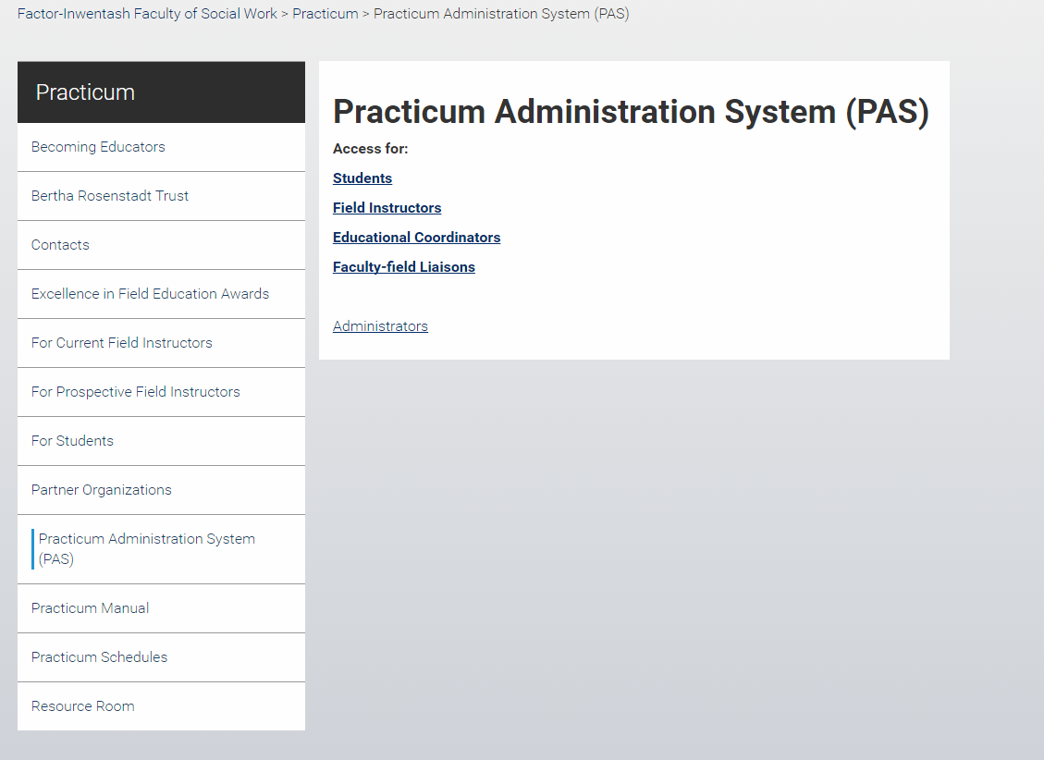

Slide 35
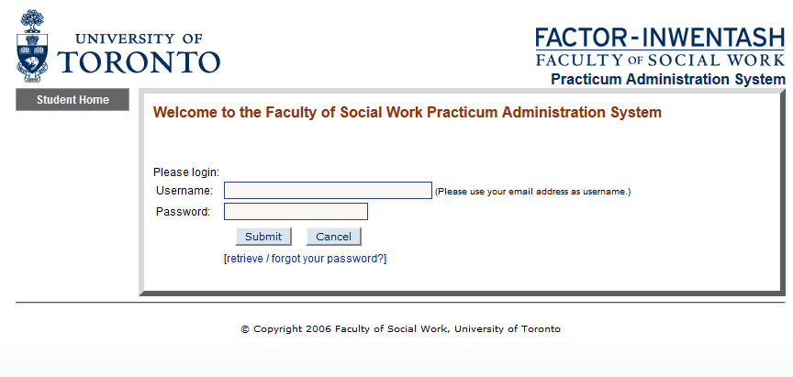
Information populated from admissions record

Slide 36
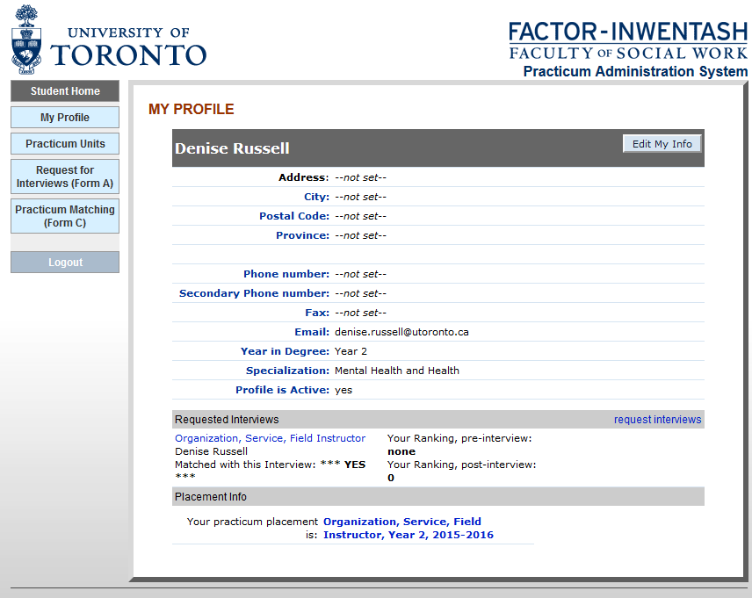
Information populated from admissions record

Slide 37
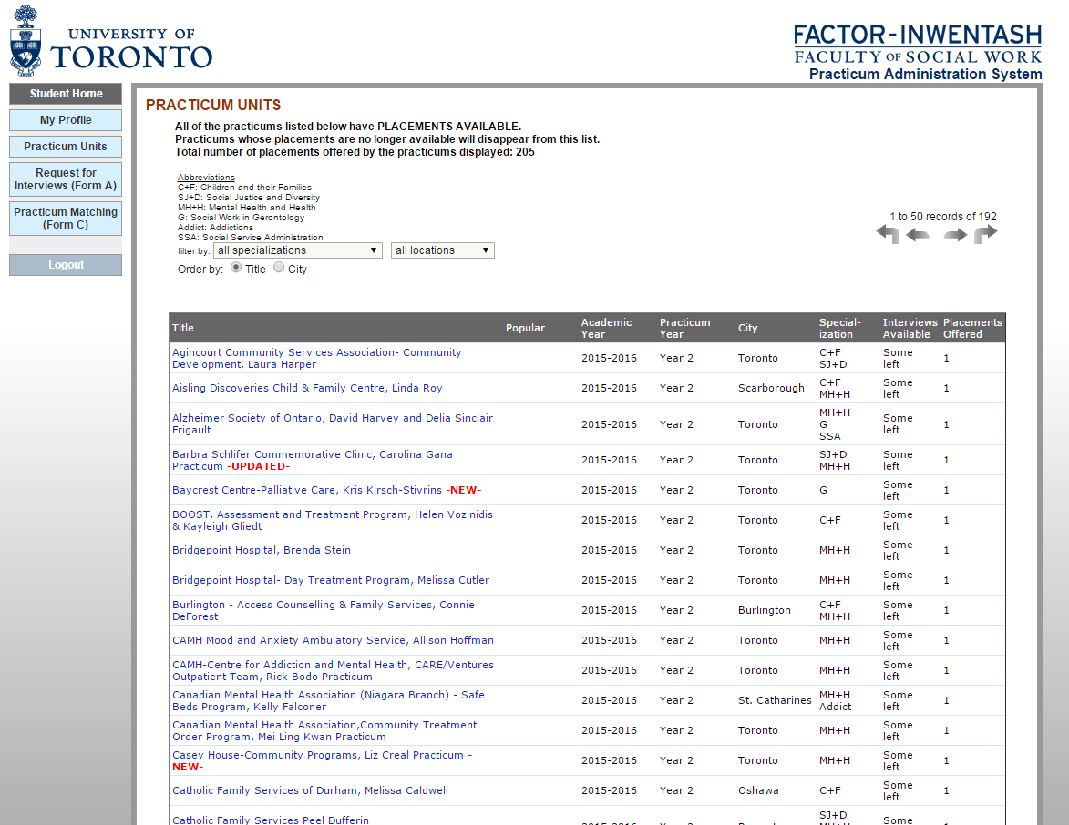

Slide 38
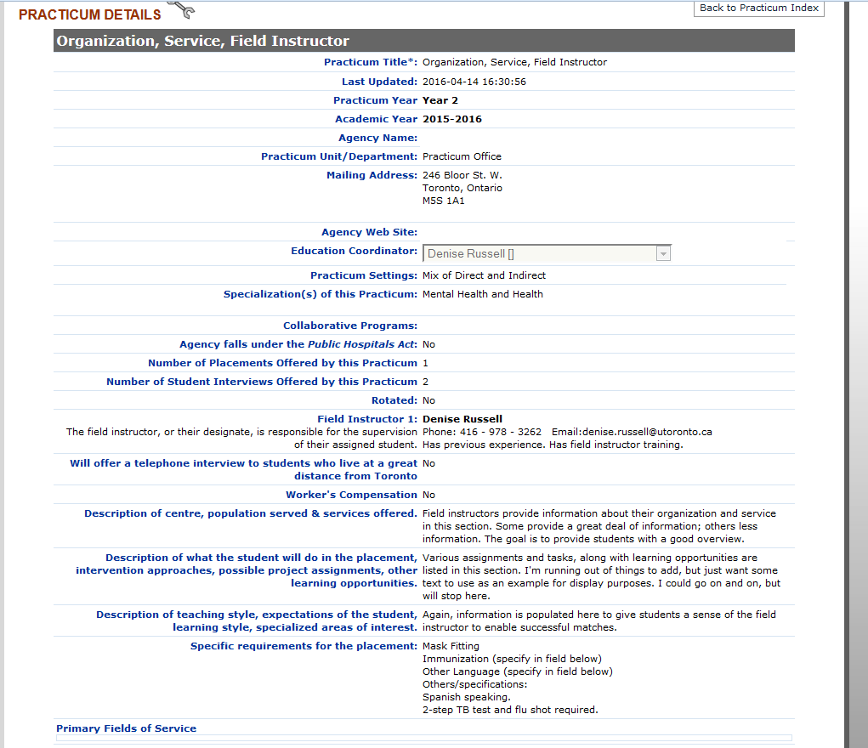

Slide 39
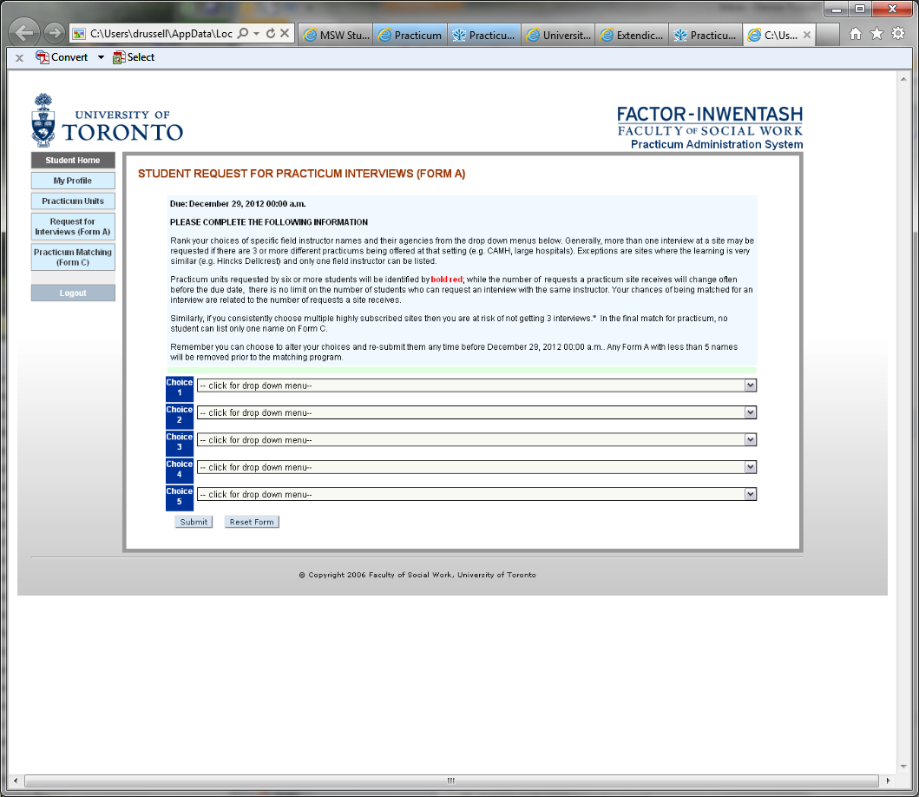

Slide 40
After the PAS is run, the Practicum Office may receive new practicum opportunities.
New opportunities are first available to students who were not matched with a practicum interview in the first run of the PAS.

Slide 41
Tentative Schedule For the Matching Process
Detailed dates, times and deadlines will be communicated to you soon through email and through the Practicum page of the FIFSW website
Tentative:
Early November 2019 - PAS will be open to view and read practicum opportunities. You will have about one week to submit selections before Form A is due

Slide 42
Tentative Schedule (cont.)
The PAS will then close for about 3-4 days while the Practicum Office runs the algorithm
Students who were not matched with an interview will be contacted before the PAS opens for viewing
When the PAS reopens, your interview match will be located on your PAS profile
Interviews occur during the months of November and December 2019

Slide 43
TRADING YOUR PAS ASSIGNED PRACTICUM
After you view your assigned practicum you may trade with another classmate
Instructions and time frame for trading will be forwarded by email
Field instructors also view the interview match
Field Instructors expect to be contacted by you to arrange the interview. EXCEPT IF YOU PLAN TO TRADE. Do not contact Field instructor until trade is completed.

Slide 44
The Interviews
Resumes, cover letters - ask Field Instructor(s) prior to the interview if they wish to receive a resume
This is a learning opportunity- let them know what you want to learn
This is your confirmed YEAR I practicum - unless there is a compelling reason from you or from the field instructor(s).
If after your interview you have concerns about the practicum contact the Practicum Office immediately
We know you know: Please treat this interview in a professional manner

Slide 45
How to Interview
Tips on interviewing are available, please take advantage of U of T Career Counseling Centre.
https://www.utm.utoronto.ca/careers/career-planning/career-counselling
The Practicum Office is pleased to discuss

Slide 46
PLEASE BE ADVISED
Our partner organizations have set out protocol for practicums. Students cannot negotiate personal and informal arrangements. Field instructors who were approached by a student without the collaboration of the Practicum Office, will be asked by the Practicum Office to offer their practicum to all students in the cohort. If the field instructor agrees, the practicum will be posted on the PAS for all.
As before, if there is an organization that is not listed, and you wish more information, please meet with the Practicum Office

Slide 47
Practicums outside of PAS Process (2019-2020)
Competitive YEAR I Practicum opportunities are available.
“Competitive” because they are also available to other academic institutions
Whereas practicums listed on the PAS are confirmed to go forward (unless the unexpected occurs at the org or field instructor)
Competitive opportunities are listed on the FIFSW website with the application closing dates. Copy Miri
You may apply to these opportunities AND participate in the PAS process. Instructions are on the FIFSW website
http://socialwork.utoronto.ca/practicum/for-students/year-1/competitive-year-1-practicum-opportunities

Slide 48
Other Practicum Opportunities
Melbourne - visit FIFSW website (YEAR II) 2021
Hebrew University – 2 spaces confirmed Summer 2020 Contact centre for international experience. The may have a workshop
Edinburgh Scotland - 2 spaces confirmed summer 2020 YEAR I
Information located on the website. Contact Eileen McKee, Assistant Dean Field Education

Slide 49
Always in Motion
The PAS is not static. Practicums are added and withdrawn
By email the Practicum Office will communicate to students who selected a practicum which is withdrawn
Revisit the PAS regularly before submitting FORM A
Our subject line is: IMPORTANT PRACTICUM INFORMATION

Slide 50
Faculty Field Liaison (FFL)
Your assigned FFL is your “go to” person
The name of your FFL will be on your PAS profile before practicum begins
Group meetings with your FFL occur throughout the academic year at the FIFSW (approx. 4 group meetings)
Meeting time and location is listed on the FIFSW website
Attendance is expected

Slide 51
Accommodations
If accommodations are required, it is a requirement that you register with U of T Accessibility Office. The Practicum Office will work with you
Notify the Practicum Office as early as possible, preferably before the PAS is run.

Slide 52
If you are in a combined degree program or plan on a collaborative program please advise the Practicum Office

Slide 53
Practicum Manual
On the FIFSW website
Read through the Practicum Manual at:
  http://socialwork.utoronto.ca/practicum/practicum-manual-2/
Regularly check the Schedule on the website

Slide 54
Partner Organizations
A list of organizations partnered with FIFSW are listed on the FIFSW website
These practicums may or may not be offered in the academic year 2019-2020

Slide 55
Reminder
Condition of Admission to the FIFSW was your signature acknowledging adherence to the Social Work Code of Ethics and the Guidelines for Ethical Practice

Slide 56
Practicum Quick Links under “Students”
Quick Links Forms & Information
Learning Contracts and Evaluations
Requirements For detailed information about refer to the “Requirements” section on the PAS profile
Police Reference/Vulnerable Sector Checks
Immunization Health Record Form
Mask Fitting – N95 Questionnaire
Checklist I Practicum Safety and Learning
Checklist II Practicum Learning and Reflection
Course Add/Drop and Extension Forms
Course Add, Drop and Extension Forms
Competitive and / or Outside of the Greater Toronto Area (GTA) Practicums
List of Competitive and/or Outside of the Greater Toronto Area (GTA) Practicums
International Study Opportunities
The Factor-Inwentash Faculty of Social Work is excited to offer two international study opportunities:
Hebrew University, Israel
Fact Sheet on MSW Study Opportunity at Hebrew University, Israel
University of Melbourne, Australia
Fact Sheet on MSW Practicum Opportunity at Melbourne University, Australia.
Becoming Field Educators

Slide 57
How to Give Feed Back
The Practicum Manual provides a list of avenues through which you may provide feedback about the practicum matching process.
There will be a YEAR I Forum in the New Year where you are invited to provide suggestions, concerns and comments about the assignment process

Slide 58
In the Spirit of Transparency
The Toronto Star March 16, 2017
Excerpt:
Ontario student slapped with $25K fine for snooping on personal health info
The Information and Privacy Commissioner’s office says the masters of social work student was on an educational placement with a family health team in Central Huron when she accessed the information without authorization

Slide 59
Two More Thoughts
Quote in Now Magazine January 2016 from a FIFSW graduate who came to the program with 2 degrees and prior work experience
“The first foundational year allowed me to get into social work as a profession. Most social work students have a good idea what they want to do. The foundational year rids you of the notion that you know what you’re doing”

Slide 60
The Value in Being Open Minded
She continues: “I took a placement that was … assigned to me at….I hadn’t considered working with children and families, so I tried to keep an open mind, and it was transformative for me. It gave me a totally different understanding of what I wanted to be as a social worker” Now January 2016

Slide 61
Questions

